Slide 1
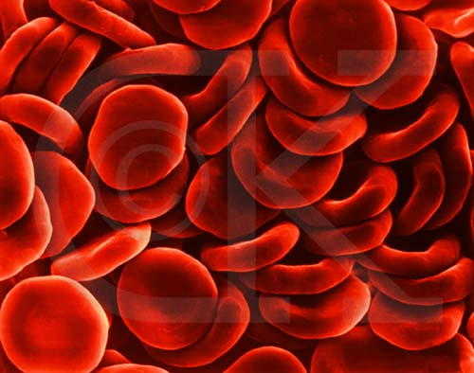
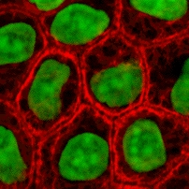
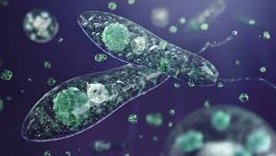
Cells
The functional and structural unit of all living organisms.

Slide 2
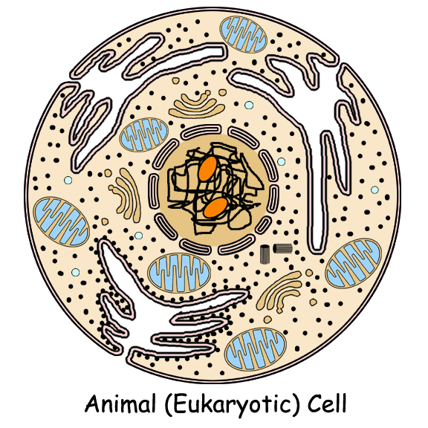
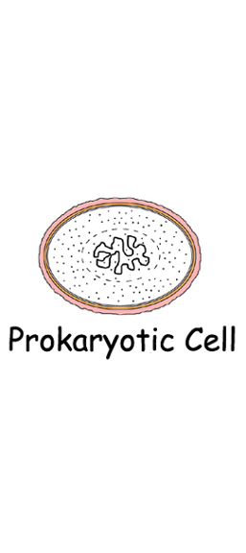
Types of cells
Eukaryotic Cells
Prokaryotic Cells

Slide 3
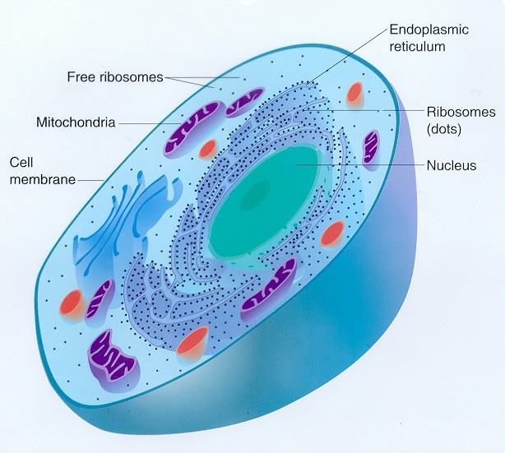
Eukaryotic cells
Cells which contain a membrane bound nucleus and membrane encased organelles.
Unicellular (Protists) and Multicellular (Plants, Animals)
DNA is contained within
the nucleus

Slide 4
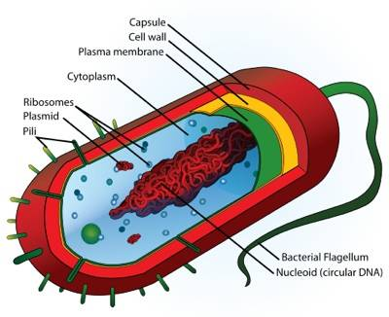
Prokaryotic cells
Cells which lack a membrane bound nucleus and any membrane encased organelles
Unicellular
Have a cell membrane, ribosomes and
DNA (genetic material) in the
cytoplasm.

Slide 5
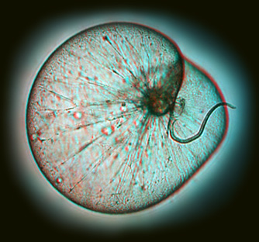
Unicellular organisms
Consist of only one cell
Examples: -Bacteria -Protists

Slide 6
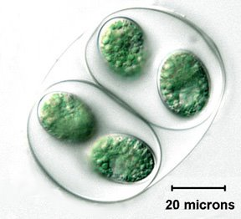
Multicellular organisms
Consist of more than one cell
Examples: -Fungi -Plants -Animals

Slide 7
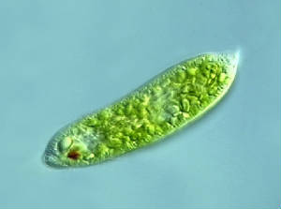
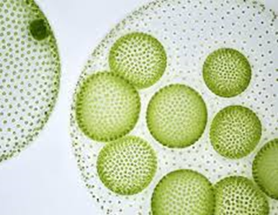
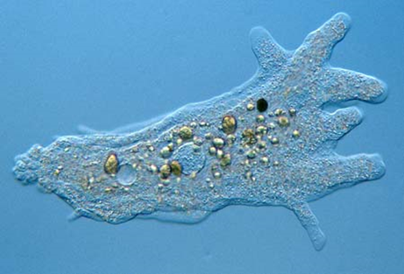
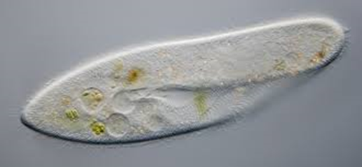
Protists
Very diverse, single celled organisms
Eukaryotic
We will look at 4 different types: 1. Amoeba 2. Euglena 3. Paramecium 4. Volvox

