Slide 1
The Encomienda System: Life in the Spanish Colonies
Write down the BLUE information on your Guided Notes sheet!

Slide 2
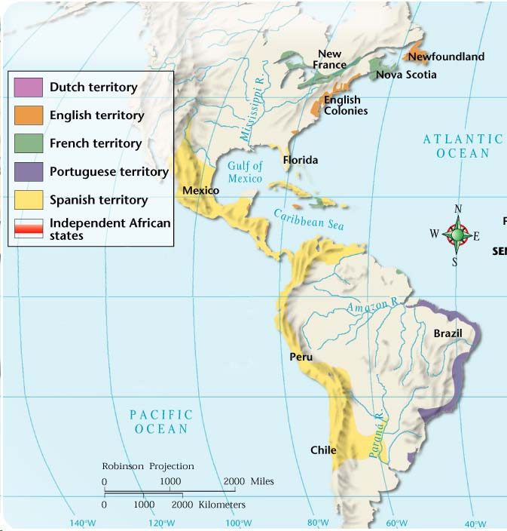
Spanish Colonies in the Americas

Slide 3
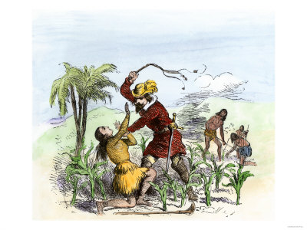

Slide 4
Encomienda
The word encomienda comes from the Spanish word “encomendar” which means to entrust.
The first encomiendas were handed out by Columbus in the Caribbean

Slide 5
The Encomienda System
What was it:
The Spanish were given control of the Natives and the land by the King and Queen
WHAT DOES THAT MEAN????
The Spanish took over the Native people
They used Natives for labor (hard work) and made them pay tribute (gifts or taxes)

Slide 6
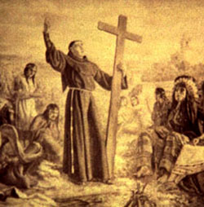
Benefit for Each Side
Natives paid tribute (gold, silver, or goods) and were made to work for a certain amount of time
In return, the owner (known as the encomendero), was responsible for the well-being of his subjects and had to see that the natives were converted to and educated about Christianity.

Slide 7
Life for the Natives
At first, life was not bad
Then:
Natives were starving
Disease killed many Natives
Paying high prices to Spanish
Worked to exhaustion
Natives couldn’t get out of this vicious cycle

Slide 8
The Vicious Cycle
Step 1: Natives work hard for conquering Spanish
Step 2: Spanish make Natives give them tributes of money, goods or hard labor
Step 3: Natives have no money to buy food
Step 4: Repeat until death

Slide 10
Colonial Class Structure
Peninsulares
People born in Spain; owned the land; ran government
Creoles
Born to Spanish parents in the Americas
Mesitzos & Mulattoes (mixed)
People with Spanish and Indian/African parents
Native Americans & Enslaved Africans

Slide 11
WHAT IS THE POINT? (EFFECTS)
The Encomienda system allowed the Spanish to MAKE MONEY and use FREE LABOR to grow crops.
Spanish are able to take over much of the New World BECAUSE of the Encomiendas
Notes:
http://www.youtube.com/watch?v=BxMGtsGmwVg

Slide 12
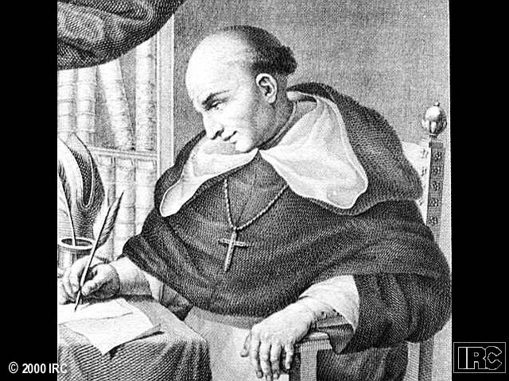
Reformers
Spanish crown was in a tough spot in regard to the encomienda system – on one hand, they benefitted from the wealth raised in the colonies, HOWEVER, they also made it very clear that the natives were not slaves but Spanish subjects with rights.
Bartolome de las Casas was a Spanish priest who believed that the natives had been treated unfairly. He believed they were just as advanced as the Europeans but in different ways.

Slide 13
New Laws of 1542
Series of laws designed to end the abuses of the encomienda system
Natives were to be guaranteed their rights as citizens and could not be forced to work
Only reasonable tribute could be collected, but any additional work was to be paid for
Anyone who abused natives could lose their encomiendas

Slide 14
The End of the Encomienda System
Encomienda system was essentially slavery approved by the Spanish crown
Many encomendors lost their land after they refused to follow New Laws of 1542
New Laws provided basic human rights to natives living in the Spanish colonies – right to be paid for work and right to not be unreasonably taxed
The fact that settlers rebelled against the New Laws shows how deeply they were driven by greed

Slide 15
Encomienda System
Video: http://www.youtube.com/watch?v=BxMGtsGmwVg

