Slide 1
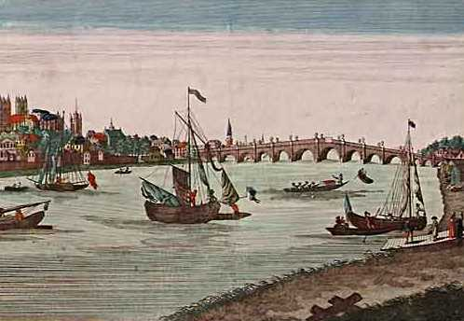
Europeans Exploration & Mercantilism
Directions: Complete your guided notes while we go over the basics of mercantilism.

Slide 2
1. Start of Mercantilism
Became popular in Europe in the 1500s
Primary reason behind European desire to conquer new lands
Basic idea states that there is a certain amount of wealth in the world, and it’s a nation’s best interest to accumulate it

Slide 3

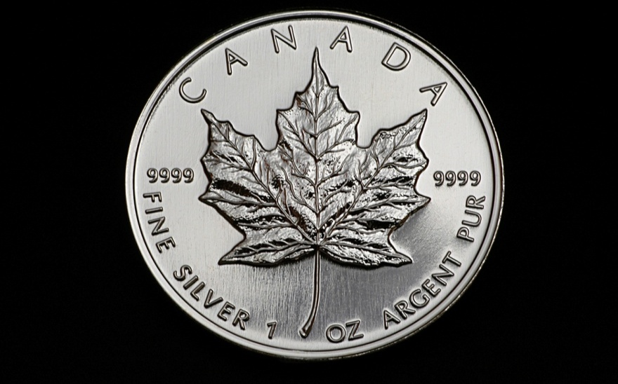
2. Mercantilism
European countries believed the more bullion (gold and silver) the more powerful you were.
Government sought to control and regulate trade- balance of trade.

Slide 4
3. Mercantilism step-by-step
A. First- you had to export more than you imported.
B. Second- build colonies- they will give you raw materials and products that you don’t have so you can export them and provide a market for finished products.

Slide 5
3. Steps Continued
C. Third- keep foreign goods out of your country with high tariffs, or taxes.
D. Fourth- increase imports by preventing colonies from trading with other nations- colonies can only trade with the mother country.

Slide 6
Colonies are Perfect Fit!
Profits are large when a country spends a small amount of money on raw materials
Mother countries could then charge high prices for the finished product
Colonies in the New World would be perfect place to find new supply of raw materials!!!

Slide 7
Who wins in Mercantilism?
Mercantilism serves the interests of the empire & mother country (not the colony)
Colonies could not sell their raw materials to anyone other than the mother country
Colonists were not allowed to manufacture or produce goods in the colonies – this process was completed in Europe
Empire WINS! Colony LOSES!

Slide 8
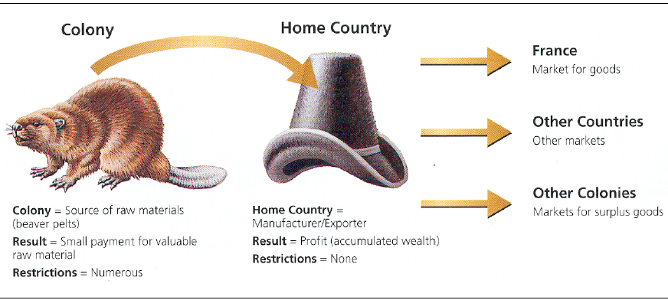

Slide 9

Mercantilism Video

Slide 10
Who is the Richest Empire in the World?
Mercantilism Simulation
Objective: I can learn how wealth and power motivated European countries during colonization.

Slide 11
Main Goal of Today
The goal of the simulation activity is to show you why colonies were so important to control, conquer, and exploit under the mercantile codes. Let the contest for the richest empire begin!!!

Slide 12
Four Objectives to Wealth
To claim and settle as many islands as possible.
To exploit the colonial settlements by taking the islands natural resources such as food and raw materials (gold and cotton).
To return the natural resources to your European empire.
To sell and export the raw materials in order to make your empire the richest and most powerful in the world.

Slide 13
RULES!!!
Only the person wearing the “Admiral” hat can search for land (islands) to claim
All remaining members in your empire must stay in their seats
A different “Admiral” must hunt for land each voyage (relay)
You may only claim one island per voyage
Any raw materials that fall off during your return voyage are lost at sea (no one can claim them)
No one is allowed to hurt or bully another “Admiral”

Slide 14
Now on to the Market!
Once all of the islands have been claimed and resources collected, your empire is ready to begin exporting your goods.
VALUES of each resource “poof”
  RED = _?_
  WHITE = _?_
Tolls and Tariffs to sell at market
  Gold – 200 per “poof”
  Cotton – 100 per “poof”

Slide 15
Reflection
Who is the wealthiest empire in our class today?
What did we learn today about mercantilism? The race for colonies?

Slide 16
The Game of Mercantilism
Read the handout in front of you to complete questions #4-8 on your Mercantilism notes

Slide 17
4. Explain the meaning of the term “mercantilism” in your own words.
Answers will vary – any volunteers?

Slide 18
5. Why did the rulers of European countries want to see joint-stock companies formed and trading posts and plantations set up?
Rulers collected a percentage of company profits
Valuable products were gathered at trading posts and sent back to home country

Slide 19
6. Why did kings want their colonies to trade only with the mother country?
The prices of products sold to mother country were lower than what could be charge if sold to other European nations
Cheaper prices for mother country

Slide 20
7. Why did the colonists smuggle goods into the English Colonies?
Colonists were forced to buy manufactured products only from England at whatever prices English merchants demanded

Slide 21
8. What reasons did kings have for thinking that mercantilism was the way to power?
If money flowed into treasury, the king could afford a life of luxury
Could build a large navy to protect colonies
He could hire mercenaries to fight his battles

