Slide 1
Warm Up
Go to the table by the calendar and grab an Age of Exploration Vocabulary Sheet.
Update your Table of Contents
Once your Table of Contents is up to date,
begin filling out the “My Guess” column
of the Age of Exploration Vocabulary
Entry | Date | Title
8 | 09-08 | Age of Exploration Vocabulary
9 | 09-08 | Motive for Exploration

Slide 2
Motives for Exploration

Slide 3
Why did explorations happen when they did?
A variety of factors all came together to make the time period (1400-1600) the “age of exploration”
Some of these factors were pushes, external forces acting on Europe
Some were pulls, motivations and things that attracted the Europeans

Slide 4
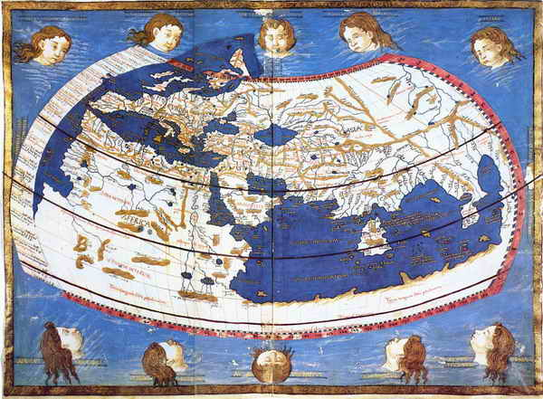
Medieval Map of the World

Slide 5
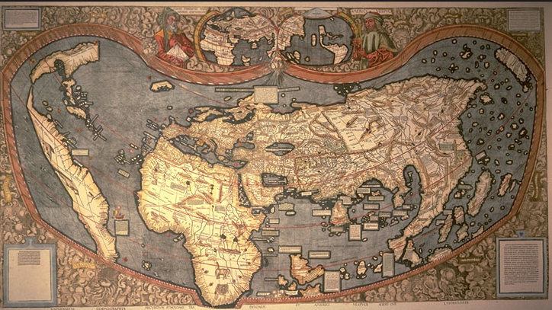
“World” Map 1507

Slide 6
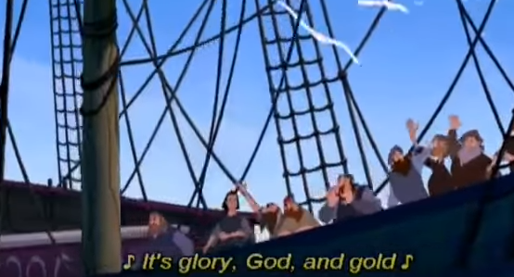
What is the easiest way to remember it all?
The Three G’s:
  Gold
  Glory
  God
Although a little simplistic, this is a great way to remember the main motivations of the European explorers.

Slide 7
The First G: Gold
Gold was a hot item that explorers were looking for, but remember that it is really wealth that explorers were after.
Europe needed gold (and silver) to fuel the rising banking system
Europeans also desired spices and other luxury items (Da Gama’s voyage to India made him a 3000% profit!)
Other natural resources would come to be sold for profit as well (timber, sugar, tobacco, ivory, etc.)
This competition will be enhanced by the idea of mercantilism that emerges, the idea that there is only so much wealth in the world, and that to make your kingdom strong you must have more gold and wealth than the other kingdoms

Slide 8
G for Gold and also Goods
The desire for new sources of wealth not only applied to gold, but also to new goods.
Through overseas exploration, merchants and traders hoped ultimately to benefit from what had become a profitable business in Europe: the trade of spices and other luxury goods from Asia
Merchants hoped to make large profits from the trade of spices and other goods from Asia

Slide 9
Gold & Goods
After the Crusades from 1096 to 1270 Europeans continued to demand such spices as nutmeg, ginger, cinnamon, and pepper—all of which added flavor to the bland foods of Europe.
Because the demand for these goods was greater than the supply, merchants could charge high prices and thus make great profits.

Slide 10
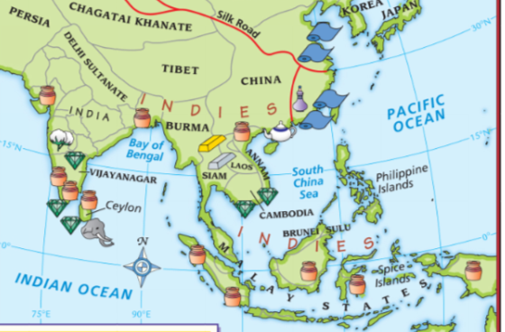
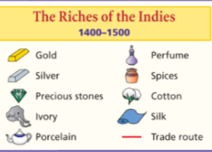

Slide 11
He Who Controls Trade Controls All
The Muslims and Italians controlled all the goods from East to West.
Muslims sold Asian goods to Italian merchants, who controlled trade across the land routes of the Mediterranean region.
Italian merchants resold the items at increased prices to merchants throughout Europe.

Slide 12
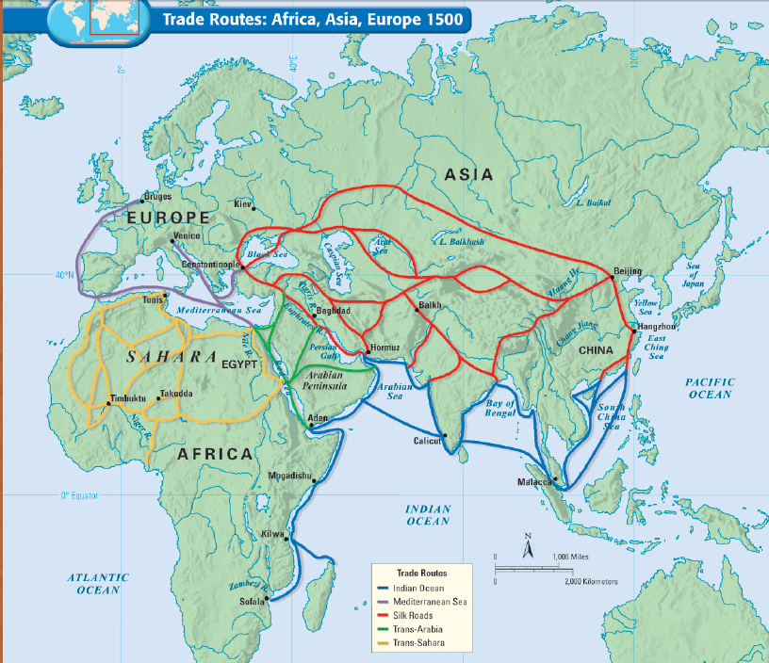

Slide 13
Change is Good
Other European traders did not like this arrangement. Paying such high prices to the Italians severely cut into their profits.
By the 1400s European merchants—as well as the new monarchs of England, Spain, Portugal, and France---sought to bypass the Italian merchants. This meant finding a sea route directly to Asia.

Slide 14
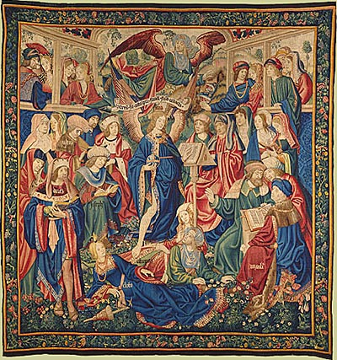
The Second G: Glory
Just like the first G, Gold, Glory was a relatively new idea in Europe
Came out of the Renaissance ideal of Humanism, and the focus on individual achievement
With the rise of the printing press, the idea of gaining fame for one’s actions was more possible
Also, individual kings wanted glory for their kingdoms, competition spreads
The Triumph of Fame, a Flemish tapestry from 1502.

Slide 15
The Third G: God
As members of a universalizing religion, Europeans had always seen spreading Christianity as a good thing.
The desire to spread Christianity also fueled European exploration.
Aside from leaving Europeans with a taste for spices, the Crusades left feelings of hostility between Christians and Muslims.
European nations believed that they had a sacred duty to convert non-Christians.
Especially after the Reformation, competition arose between religions.

Slide 16
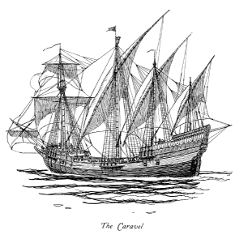
What were the new technologies that enabled explorations?
The caravel was a new, faster, more maneuverable ship
Older ships had square sails, caravels had triangular sails (easier to change direction)
Bilge pump system enabled ship to float higher (less likely to run aground, easier to explore coasts and rivers)
Compass, astrolabe, maps and other technologies from Islamic culture all helped make explorations possible

Slide 17
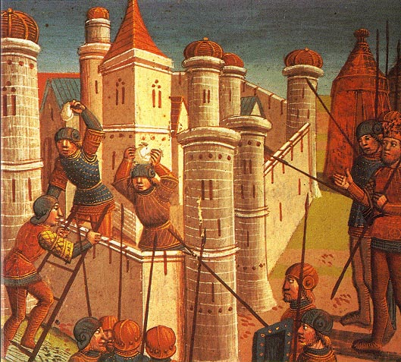
What factors were pushing Europeans to explore?
Decline of Mongol Empire in 1400s made goods from the east harder to get, more expensive
Fall of Constantinople to the Ottoman Turks in 1453 was a major block to trade

Slide 18
Homework!
Students have the option to complete ONE of the following
  Flash Cards for the Age of Exploration Vocabulary
  Flip Chart for the Age of Exploration Vocabulary
  Either one will be checked on Monday for a homework grade. A homework pass will be accepted for this assignment if you have one.

