Slide 1
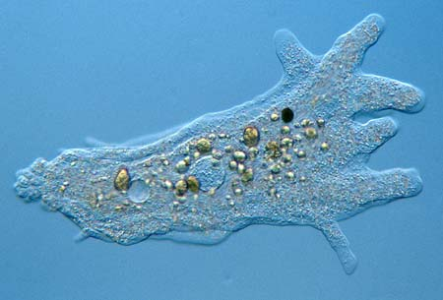
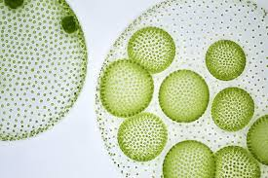
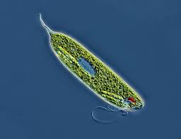
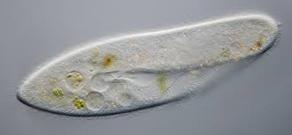
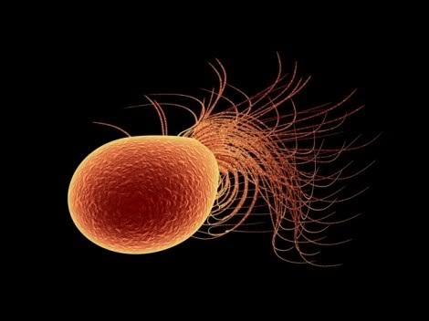
Protists

Slide 2
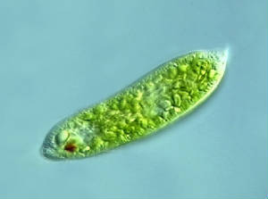
Protists
Very diverse, single celled organisms
Eukaryotic
We will look at 4 different types: 1. Euglena 2. Amoeba 3. Paramecium 4. Volvox

Slide 3
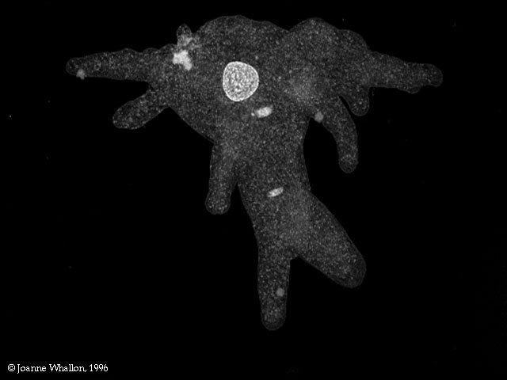
Amoeba
Unicellular structure
Found in fresh water (ponds and puddles) and salt water around dead and decaying material
Move with pseudopodia (false feet): finger-like extensions of cytoplasm.
Forms protective cyst
when environmental
conditions are unfavorable.

Slide 4
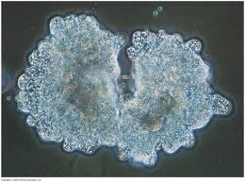
Amoeba
Food:
Takes in food through phagocytosis or engulfing the food with its pseudopodia.
Eats little plants and animals, including other protists. (amoeba’s lunch)
Waste: Contractile Vacuole holds and expels waste through cell membrane
Reproduction: Asexual (binary fission) – creates exact copy of itself.

Slide 5
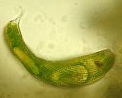
Euglena
Unicellular protists that live in fresh water (quiet ponds or puddles)
Movement via flagellum – a long whip-like structure that acts like a little motor.
Have an eyespot helps them sense light.
Form a protective cyst around them when environmental conditions are unfavorable.

Slide 6
Euglena
Food
-Producer: make their own food through photosyntheis.
-Heterotroph: obtain food by eating other tiny plants and animals.
Waste - Contractile Vacuole holds excess water and expels it from the cell.
Reproduction: Asexual (binary fission)

Slide 7
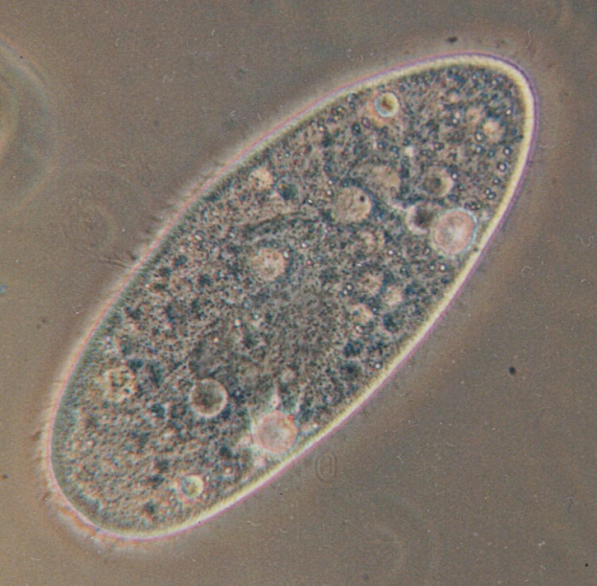
Paramecium
Found in freshwater and marine environments
Unicellular organism, but more complex than other single cell organisms
Movement via cilia: tiny hairs which move back and forth
Have two nuclei-Macronucleus and Micronucleus
Avoidance behavior and trichocysts (Spiderman-like skills) for defense. trichocyst

Slide 8
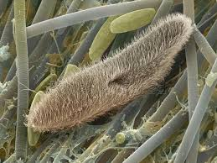
Paramecium
Energy from Food:
- Consume smaller protozoans.
- Cilia are used to sweep food into the oral groove
Waste:
-Anal Pore: food waste is removed
-Contractile Vacuole: water waste
Reproduction- Binary Fission with
occasional conjugation

Slide 9
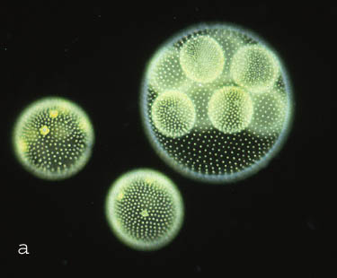
Volvox
Commonly called algae
Found in ponds, ditches, and puddles.
Unicellular organisms that live in a colony of tiny flagellate cells. (More than 50,000)
Eyespots to help sense light.
Each volvox has 2 flagella. All individual volvox move them in unison to move the whole colony.

Slide 10
Volvox
Food:
- Produce own food through Photosynthesis
Waste: Remove oxygen waste through the cell membrane
Reproduction:
-Asexual: daughters colonies created

