Slide 1
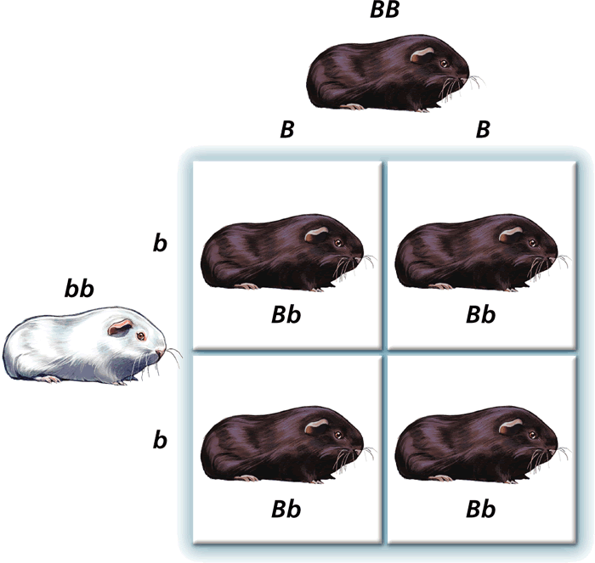
Mendelian Genetics - Probability and Heredity Punnett Squares Part 1

Slide 2
Gregor Mendel
An Austrian monk who had a major, lasting impact on the field of genetics.
He taught math and science to the other monks at the monastery and also worked as a gardener.
He was curious why some kinds of plants showed different traits.

Slide 3
Studied the inheritance of traits in pea plants.
Why peas?
º Monks raised 22 varieties
º Lots can be grown in a
small area
º Produce a variety of
different traits
º Grow quickly
º Produce lots of offspring
º And they could use his
research subjects since
they are yummy!

Slide 4
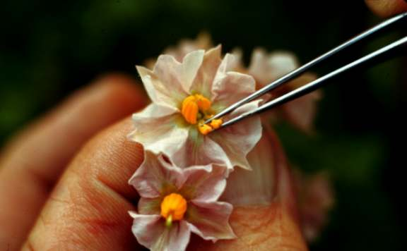
Mendel’s Experimental Methods
Mendel hand-pollinated flowers using a paintbrush
He could snip the stamens to prevent self-pollination
Covered each flower with a cloth bag
He traced traits through several generations

Slide 5
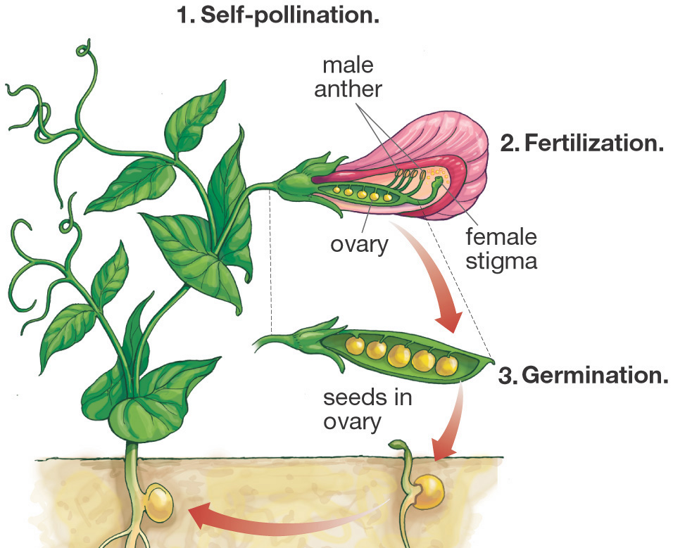
Mendel also produced pure strains by allowing the plants to self-pollinate for several generations

Slide 7
short

Slide 8
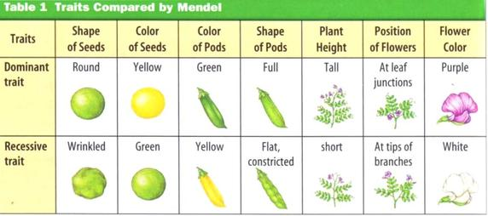
Mendel’s Experimental Results

Slide 9
Cross 2 Pure Plants TT x tt
Results in all Hybrids Tt
Cross 2 Hybrids get 3 Tall & 1 Short TT, Tt, tt

Slide 10
Father of Genetics
Mendel’s study and experimentation with pea plants laid the foundation for the study of genetic inheritance.
Like many scientists who propose new and unfamiliar ideas, Mendel's work was not recognized until the turn of the 20th century.
Because of his work, he is known as the “Father of Genetics”.

Slide 11
First, let’s look at some new vocabulary…
Genetics – the scientific study of heredity
Heredity – the passing of genes from
parents to offspring
Gene – a unit of heredity that occupies a specific spot on a chromosome
and codes for a specific product
or trait.
Allele – the various forms of the same
gene

Slide 12
An organism’s traits are controlled by the alleles that it inherits from its parents, but these alleles are not all the same.
Dominant alleles are more powerful, and can “hide” a recessive trait.
represented with an capital letter (“T” for tall stems)
Recessive alleles can be “hidden” when a dominant allele is present and are expressed only when two copies are present.
Shown with a lower-case letter (“t” for short stems)

Slide 13
What can these alleles tell us?
Genotype describes which genes or alleles are present in an organism for a trait.
TT = 2 dominant alleles
Tt = 1 dominant & 1 recessive
tt = 2 recessive alleles
Phenotype describes the physical appearance of a trait.
Tall stems = TT and Tt ( a dominant trait)
Short stems = tt (a recessive trait)

Slide 14
More vocabulary…
Scientists use 2 terms to describe GENOTYPE:
Homozygous or Purebred – the organism has 2 of the same alleles for a trait.
TT = 2 dominant alleles
tt = 2 recessive alleles
Heterozygous or Hybrid – the organism has 2 different alleles for a trait.
Tt = 1 dominant allele & 1 recessive allele
An organism can be homozygous or heterozygous
dominant, but it can only be homozygous recessive.

Slide 15
So, how can we figure out the traits that an
offspring may inherit from its parents?
We use a tool called a Punnett square to predict how likely it is for an offspring to inherit certain traits.
A PUNNETT SQUARE…
is a chart that shows ALL the possible combinations of a genetic cross.
shows genotype and phenotype of the offspring.
is also used to predict the probability (the chance) that an offspring will have a certain trait.

Slide 16
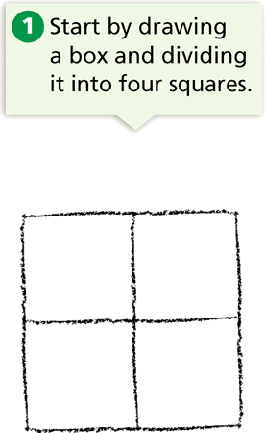
How do we draw a Punnett Square?

Slide 17
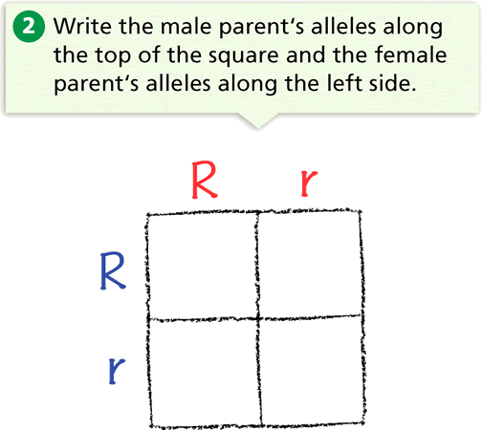
“R” is dominant for Round seeds.
“r” is recessive for wrinkled seeds.
Both parents are “heterozygous” and have round seeds.
The letter used is typically based on the dominant trait.

Slide 18
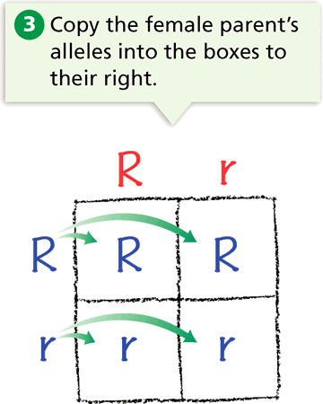

Slide 19
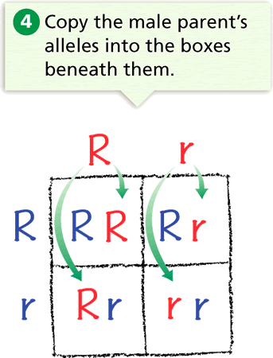

Slide 20
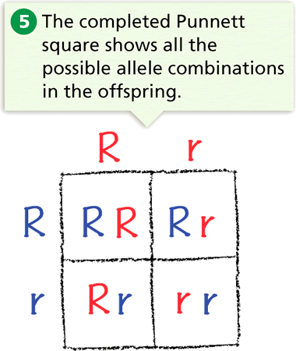

Slide 21
The two-letter combinations are the possible genotypes of the offspring.
They are RR, Rr, Rr, and rr genotypes.
From this it is possible to determine the “probability” (chance) that a seed will have:
a round seed phenotype (3/4 or 75%) OR
a wrinkled seed phenotype (1/4 or 25%)

Slide 22
Try one on your own…
Cross a homozygous male guinea pig with black fur (BB) with a homozygous female guinea pig with white fur (bb).
Black fur is dominant over white fur

Slide 23
Write the father’s alleles on the top of the punnett square and the mother’s on the side.
B
B
b
b

Slide 24
Carry the father’s alleles down to all of the boxes below them.
B
B
B
B
B
B
b
b

Slide 25
Carry the mother’s alleles to all of the boxes to the right.
B
B
b
b
b
B
B
b
b
b
B
B

Slide 26
The result?
All 4 possible offspring will be heterozygous and have one dominant allele for black fur and 1 recessive allele for white fur.
All the guinea pigs will have the heterozygous black fur phenotype; and Bb genotype. The probability of black offspring is 100%.

Slide 27
A Review of Mendel’s Peas

