Slide 1
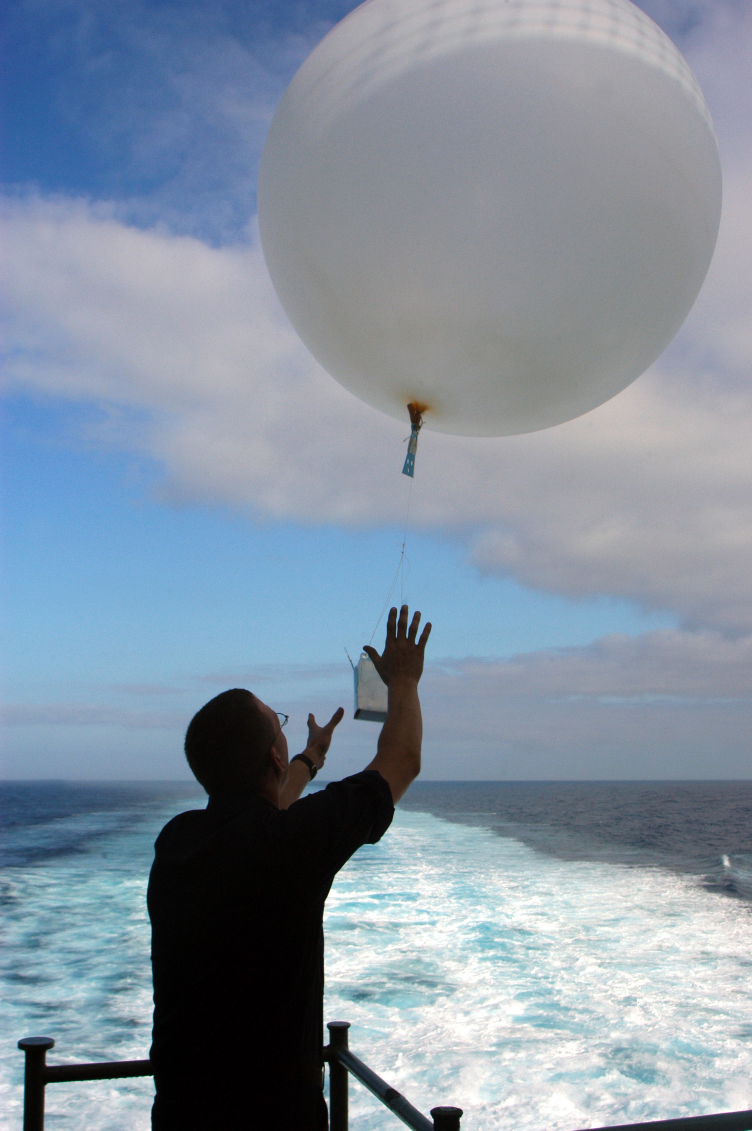
Weather balloons are launched twice a day
To collect data at different altitudes by measuring:
Temperature
Humidity
Air Pressure
Ground antennas receive the signals as the balloon rises
Computers interpret the signals and send them to the National Weather Service.

Slide 2
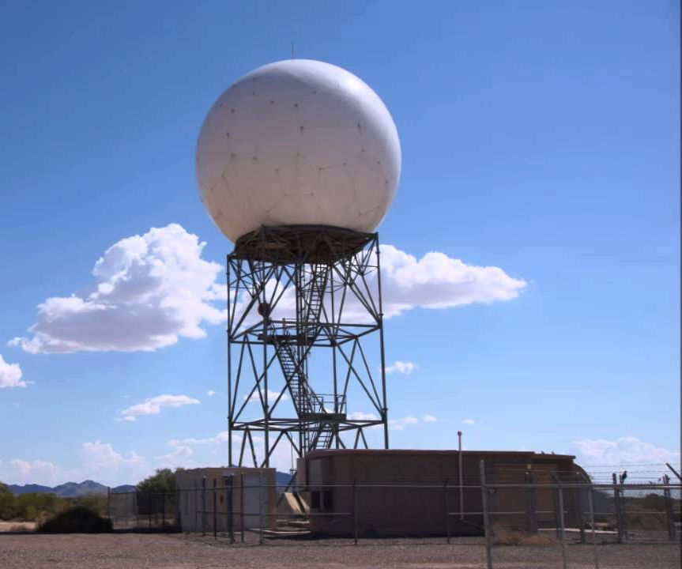
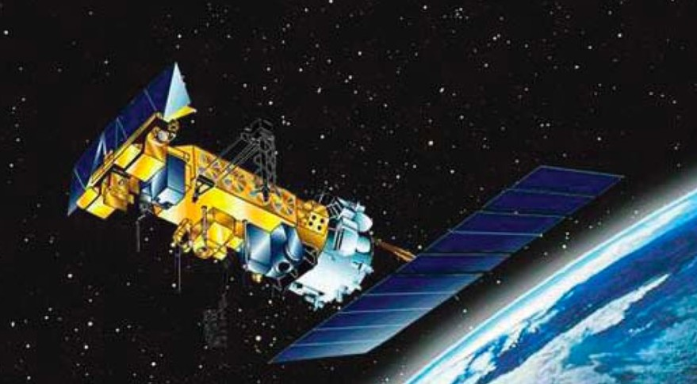
Modern weather observation also includes the use of radars and satellites
Radars - monitor clouds, precipitation and winds
Weather satellites - provide even larger views of weather systems

Slide 3
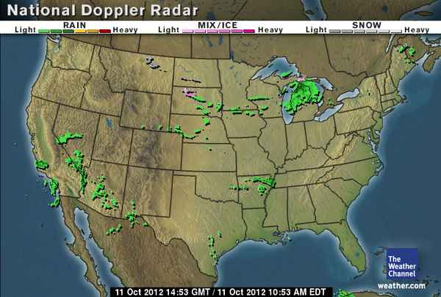
Doppler Radar

Slide 4
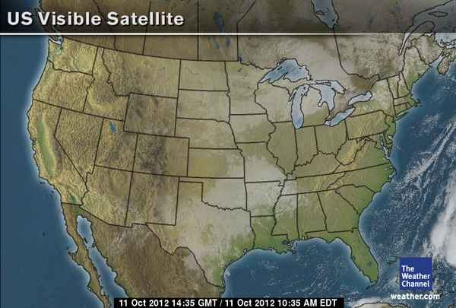
Visible Satellite

Slide 5
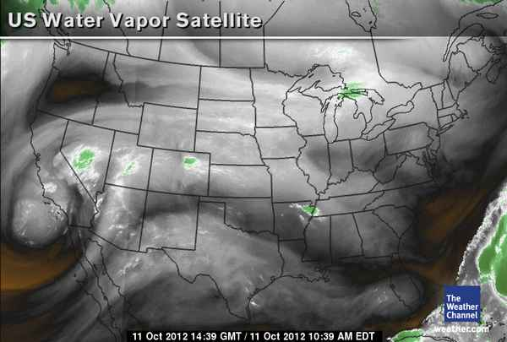
Water Vapor Satellite

Slide 6
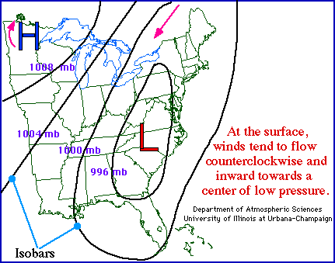
Weather Maps
Surface Maps can show pressure systems
The H stands for high pressure systems. Highs usually bring clear skies.
The L stands for low pressure systems. Lows usually bring cloudy skies with possible precipitation.

