Slide 1
Warm Up
Pick up Entry 1 from the front tray!
If you were not here yesterday, grab a new Table of Contents sheet from the absent binder!
Update your Table of Contents
4. Take out your timeline!
Dates to Remember
Monday: World War II Unit Test
Friday: Registration due!
Entry | Date | Title
1 | 04-10 | Nuclear Weapons & World War II

Slide 2
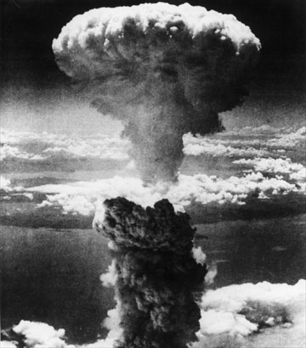
The Atomic Age: Nuclear Weapons in WWII
Write down all information in YELLOW in your notebook as
entry #1.

Slide 3
Fighting in Europe Concludes
June 6, 1944: D-Day gives the Allies a place hold in Northern France. The Germans begin retreating towards Germany.
August 1944: Allied troops reach Paris. By December, nearly all of France, Belgium, and the Netherlands are liberated.
December 16, 1944: The Germans launch a final offensive in the west (aka The Battle of the Bulge) in an attempt to re-conquer Belgium and split the Allied forces along the German border. By January of 1945, the Germans are retreating.
January 12, 1945: The Soviets march into Poland and begin liberating much of Eastern Europe
April 16, 1945: The Soviets launch a final offensive, encircling Berlin.

Slide 4
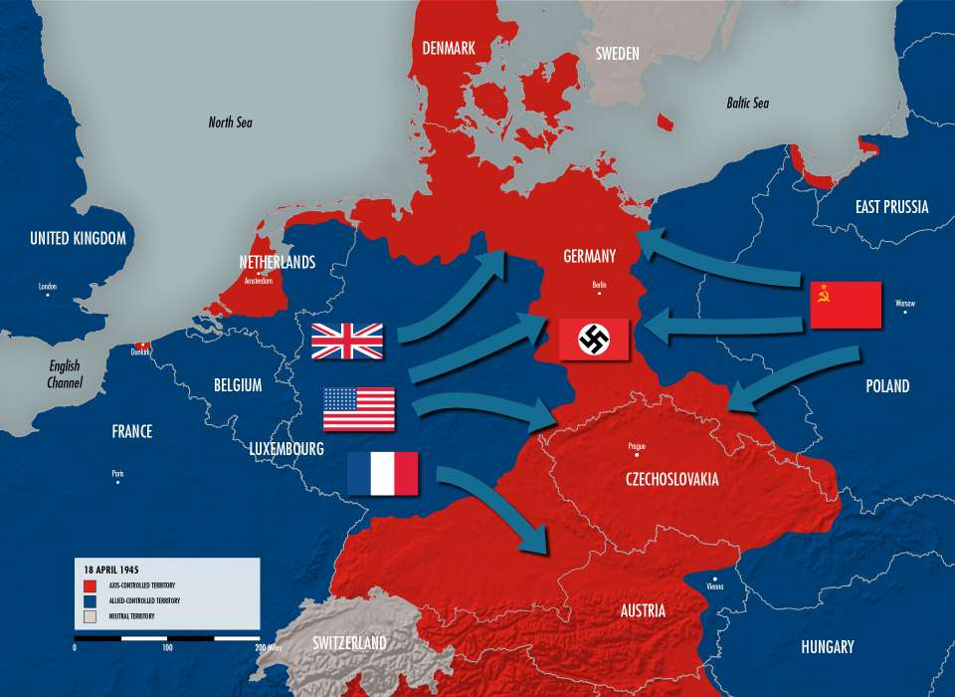

Slide 5
End of the War in Europe
By early 1945, Germany was in ruins from the constant fighting .
Allied bombers destroyed cities from the air while their armies marched across Germany.
When Hitler learned the Allied forces were within 30 miles of his underground bunker in Berlin, he shot himself to death on April 30, 1945.
German forces officially surrendered to Allied forces on May 8, 1945. This is celebrated as V-E Day (Victory in Europe Day). This was the end of WWII in Europe.

Slide 6
Japanese Surrender?
The Allied Powers had already defeated the Axis Powers in Europe, but not in the Pacific
Japan was becoming more deadly as they were being faced with defeat – kamikaze pilots became popular (trying to inflict the most damage with one plane)
America issued the Potsdam Declaration: “prompt and utter destruction” if Japan refused to surrender

Slide 7
Manhattan Project
In 1940, the United States began funding its own secret atomic weapons development program code-named the Manhattan Project
Most scientists were refugees from Europe
Operated in Los Alamos, New Mexico
Over the next few years, scientists worked on producing the key elements for nuclear fission – uranium 235 and plutonium 239.
Led by Robert Oppenheimer
July 16, 1945: first successful test of an atomic device – a plutonium bomb – at Alamogordo, New Mexico

Slide 8
Should We Use the Atomic Bomb?
Some top commanders in U.S. Army favored “Operation Downfall”
Massive ground and air assault on Japan
Truman advised that this option could leave up to one million casualties
Truman preferred using the atomic bomb
Using the bomb would bring a quick end to the war
Many also believed that using the bomb would put the United States in a dominant position in the postwar world

Slide 9
Hiroshima & Nagasaki
The first bomb “Little Boy” was dropped from the Enola Gay above Hiroshima at 8:15am on August 6, 1945 (instantly destroyed 5 square miles of the city)
The bomb exploded 2,000 feet above the city
Japan failed to surrender after the first bomb, America wanted to end the war and decided to drop a second bomb
Second bomb “Fat Man” dropped on Nagasaki on August 9, 1945 at 11:02am (based on the topography of the city, only 2.6 square miles destroyed)
Nearly 200,000 people were killed instantly, thousands of others suffered effects for years

Slide 10
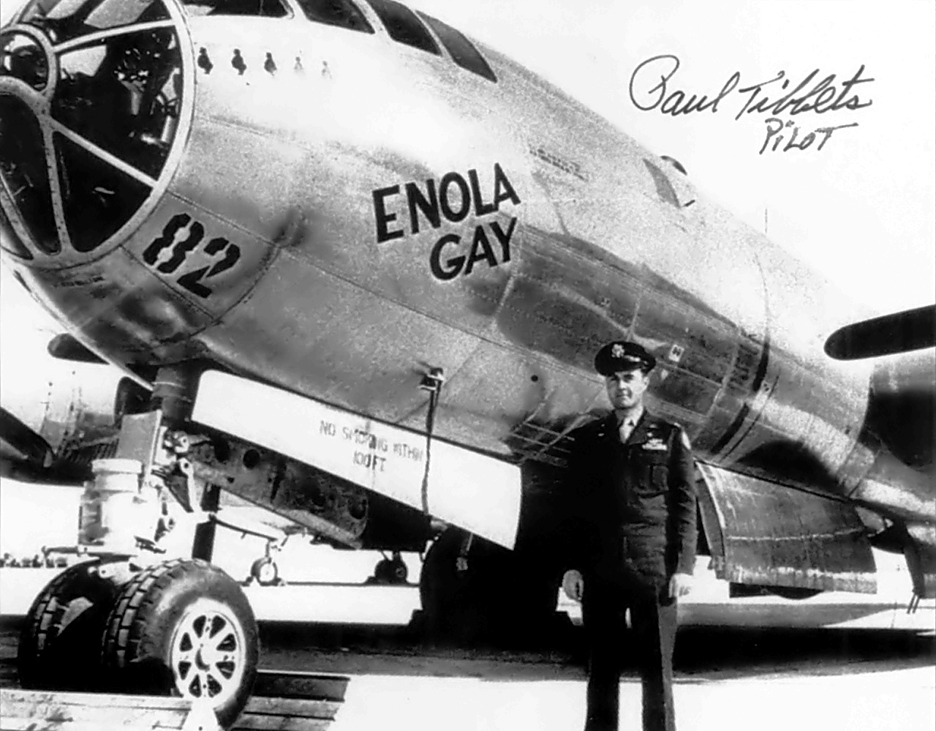
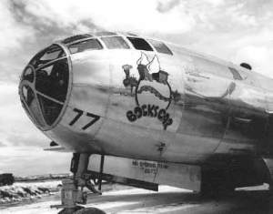

Slide 11
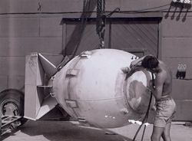
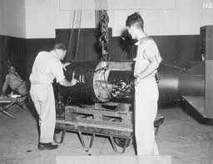
“Fat Man”
“Little Boy”

Slide 12
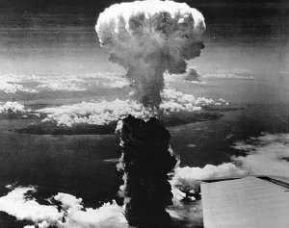

Slide 13
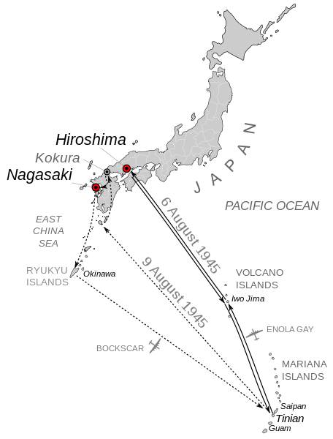
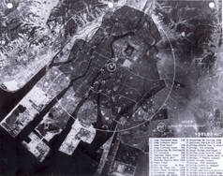
Where is Hiroshima & Nagasaki?

Slide 14
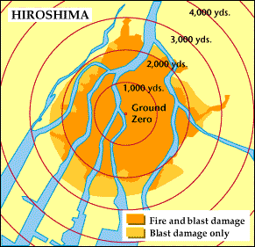
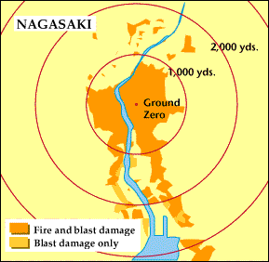

Slide 15
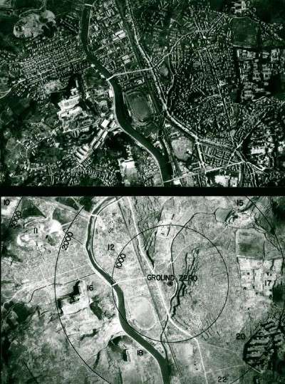

Slide 16
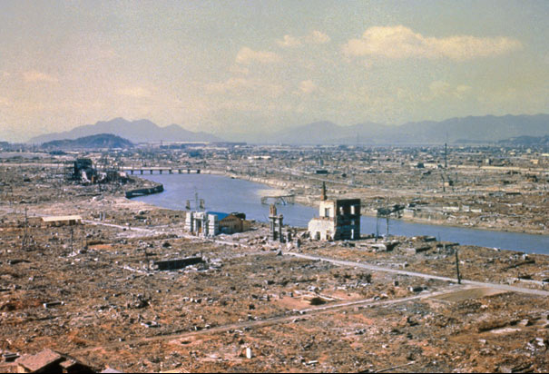
Hiroshima Aftermath: March, 1946. Eight months after the atomic bomb was dropped Hiroshima still stands in ruins. (Photo Credit: Corbis)

Slide 17
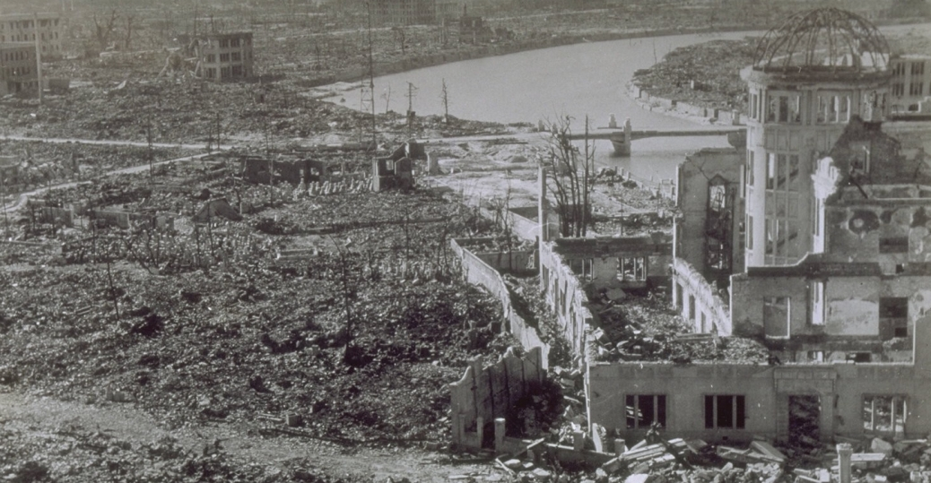
The Hiroshima Chamber of Industry and Commerce was the only building remotely close to standing near the center of the atomic bomb blast of August 6, 1945. It was left unrepaired as a reminder of the event.

Slide 18
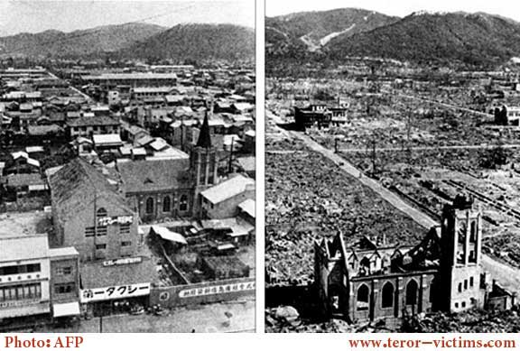

Slide 19
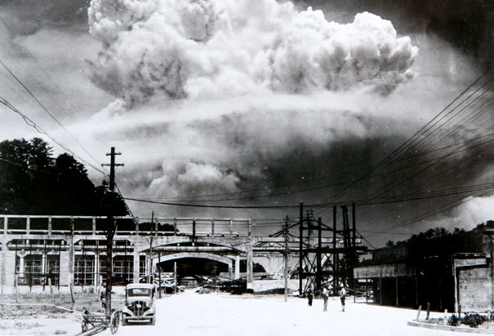
Atomic Bomb Exploding in Nagasaki: A mushroom cloud from an atomic bomb rises over Nagasaki. The second atomic bomb was dropped on the city of Nagasaki in August, 1945, in the last days of WWII shortly before the surrender of Japan. (Photo Credit: Corbis)

Slide 20
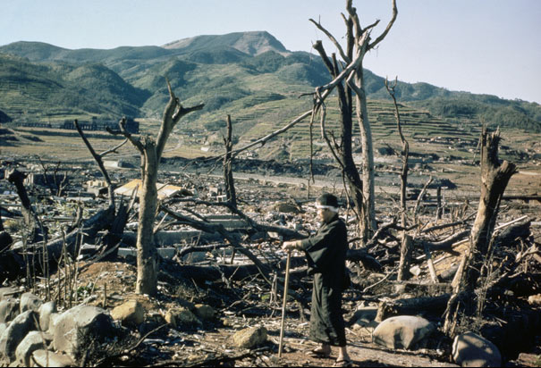
Man Walks Through Nagasaki: A Japanese man walks through the damaged lands of Nagasaki two months after the atomic bomb was dropped over the city. (Photo Credit: Corbis)

Slide 21
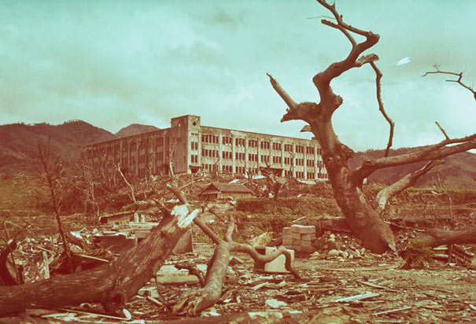
Damaged School in Nagasaki: August 13, 1945. The remains of a former elementary school and a dead tree stand in the rubble of Nagasaki a week after the atomic bomb was dropped on the city. (Photo Credit: Corbis)

Slide 22
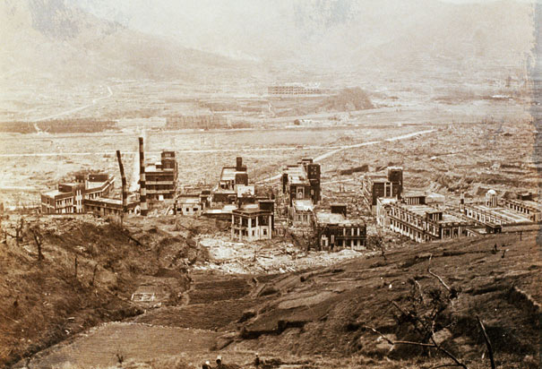
Nagasaki Medical College After Atomic Bombing: Only the reinforced concrete buildings of the Nagasaki Medical College hospital remain standing after the United States dropped its second atomic bomb on August 9, 1945. The hospital was located 800 meters from ground zero of the atomic bomb explosion. (Photo Credit: Corbis)

Slide 23
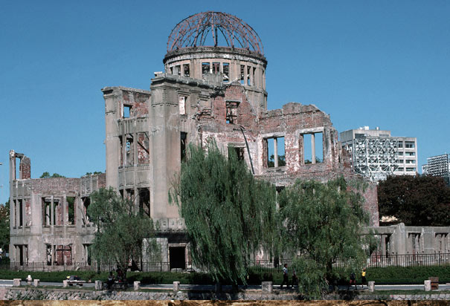
Modern Day Hiroshima Memorial: Hiroshima Memorial Park seen with modern-day Hiroshima visible in the background. (Photo Credit: Corbis)

Slide 24
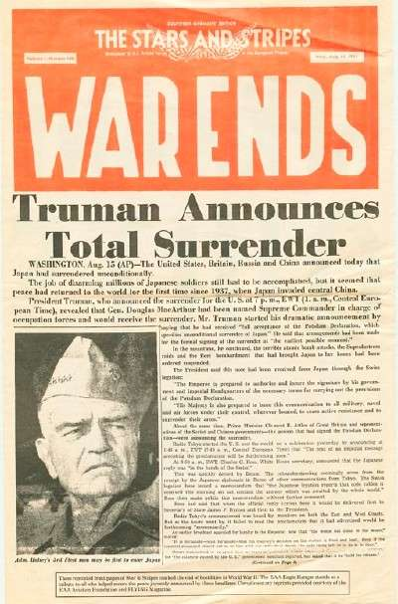
Finally Japanese Surrender
At noon on August 15, 1945, Japanese emperor Hirohito announced his country’s surrender in a radio address
Victory in Japan (V-J Day) was achieved with the formal surrender of Japan on September 2, 1945 aboard a U.S. aircraft carrier in Tokyo Bay

Slide 25
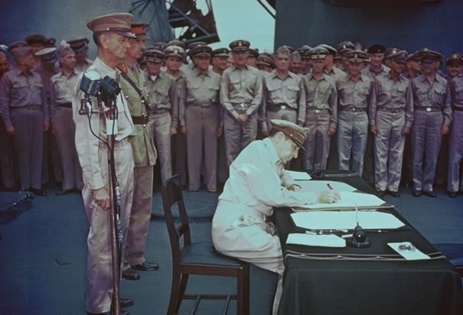
MacArthur Signs Japanese Surrender Document: General of the Army, Douglas MacArthur, Supreme Commander for the Allied Powers, signs the Japanese surrender document aboard the battleship, U.S.S. Missouri in Tokyo Bay, Japan, on September 2, 1945. At left is Lietenant General A.E. Percival, British Army. (Photo Credit: Corbis)

Slide 26
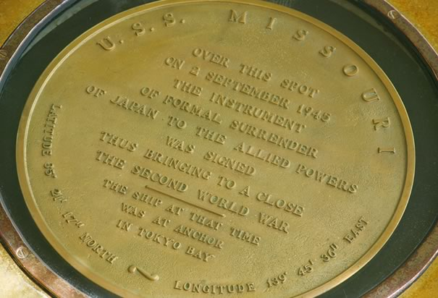
Plaque on the USS Missouri: Plaque aboard the USS Missouri. The text reads, "Over this spot on 2 September 1945 the instrument of formal surrender of Japan to the Allied Powers was signed thus bringing to a close the second world war. The ship at that time was at anchor in Tokyo Bay." (Photo Credit: Corbis)

Slide 27
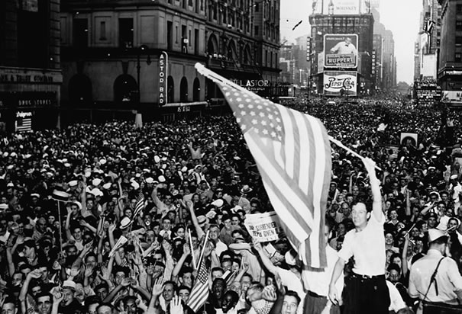
New Yorkers Celebrate VJ Day: Americans celebrate Japan's surrender. August 17, 1945. (Photo Credit: Corbis)

Slide 29
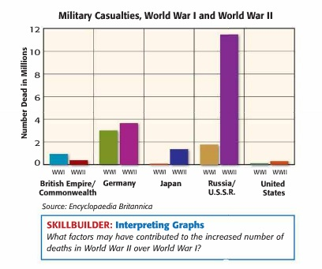

Slide 30
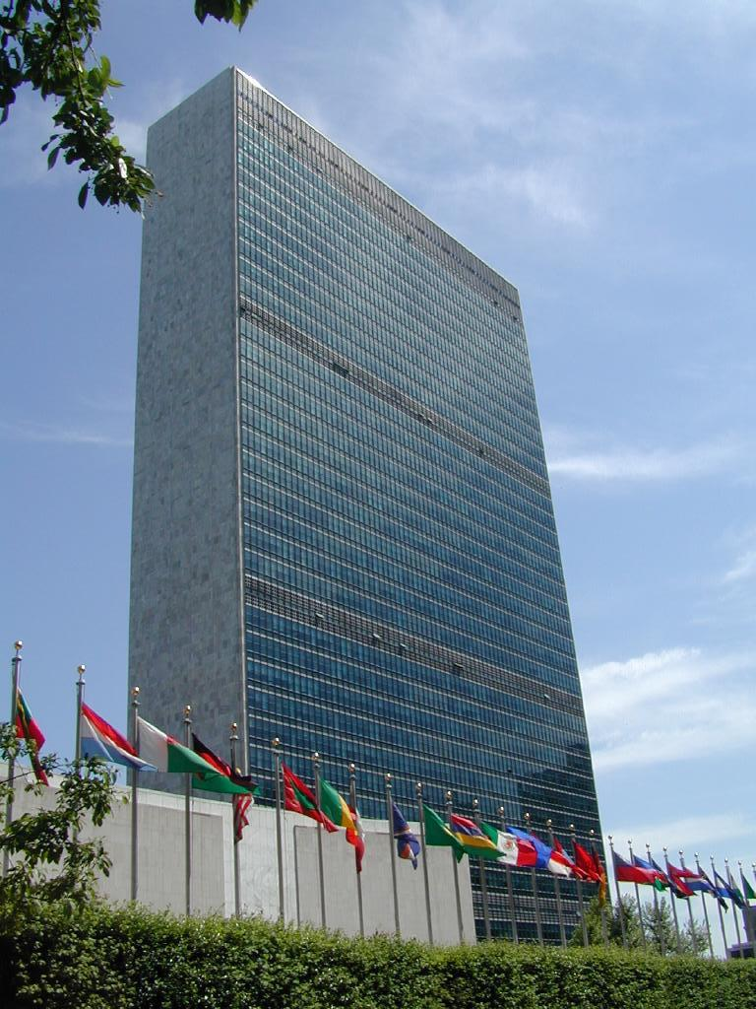
United Nations
Formed in late August 1945
Main goal: resolve disputes through diplomacy rather than armed conflict
Today more than 180 nations
belong to the UN
UN headquarters in New York City
UN has made significant
contributions to world peace but
has not completely stopped
international conflicts

