Slide 1
THE ENLIGHTENMENT IN EUROPE
Directions: Complete your Guided Notes as right-side entry #11.

Slide 2
BY THE END OF TODAY…
I can explain how different philosophers wanted to change society and the purpose of government.

Slide 3
CHANGING IDEA: THE RIGHT TO GOVERN
OLD IDEA | NEW IDEA
A monarch’s rule is justified by the divine right. | A government’s power comes from the consent of the governed.

Slide 4
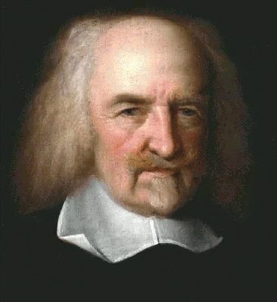
THOMAS HOBBES
Wrote his ideas about government in Leviathan (1651)
The English Civil War had convinced Hobbes that people were selfish and wicked
He said without governments to keep order, there would be constant war and life would be “solitary, poor, nasty, brutish, and short.”

Slide 5
HOBBES & GOVERNMENT
Hobbes’ Social Contract: To escape a bleak life, people hand over their rights to a strong ruler. In exchange, they gained law and order.
Hobbes believed that people acted in their own self-interest and therefore needed a ruler who had total power to control the citizens.

Slide 6
HOBBES & GOVERNMENT (CONT.)
The best government Hobbes believed had the absolute power of a Leviathan (sea monster)
Hobbes = absolute monarchy is best government because they could impose order and demand obedience

Slide 7
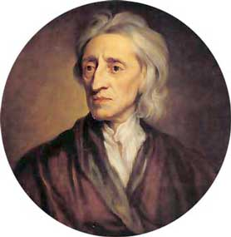
JOHN LOCKE
John Locke had a positive outlook about life and government following the English Civil War
He believed people learned from their experiences and tried to improve themselves
Locke was against absolute monarchy and favored the idea of self-government
Self-government = natural ability to govern their own affairs and look after the welfare of society

Slide 8
LOCKE & GOVERNMENT
Locke believed all people are born free and equal with three natural rights – life, liberty, and property.
The purpose of government is to protect natural rights.
If a government fails to protect natural rights, citizens have the right to overthrow it.

Slide 9
LOCKE & GOVERNMENT (CONT.)
Locke also stated that a government gets its power from the consent of the people it controls
The idea of the right to rebel against unjust rulers inspired struggles against absolute monarchies throughout Europe and the Americas

Slide 10
PHILOSOPHES ADVOCATE REASON
They had FIVE CORE BELIEFS:
REASON: Truth could be discovered through reason or logical thinking
NATURE: Believed that what was natural was good and reasonable
HAPPINESS: Philosophes believed people should seek well-being on earth (not just for the after-life)
PROGRESS: Society and mankind can improve
LIBERTY: Pushed for more liberties and protection of those granted in the English Bill of Rights

Slide 11
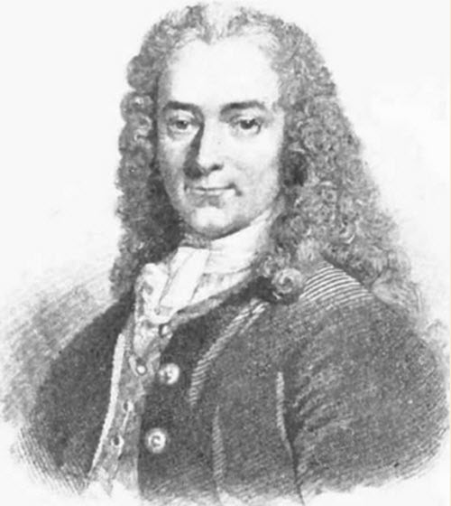
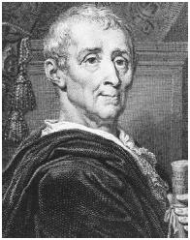
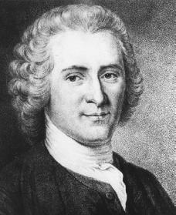
OTHER FAMOUS PHILOSOPHES DURING THE ENLIGHTENMENT
Francois Marie Arouet (Voltaire) – Free speech
Baron de Montesquieu – Separation of powers
Jean Jacques Rousseau – Individual freedoms
Voltaire
Montesquieu
Rousseau

Slide 12
VOLTAIRE
Voltaire used satire against his enemies (the use of irony, sarcasm, and wit against stupidity)
Although he made MANY enemies during his life, he never stopped fighting for tolerance, reason, freedom of religious belief, and freedom of speech.
He is most well-known for advocating for freedom of speech
Famous quote “I do not agree with a word you say but will defend to the death your right to say it”

Slide 13
MONTESQUIEU
Wrote the book On the Spirit of Laws (1748)
Proposed the idea that separation of powers within a government would keep any individual or group from gaining total control
He wrote, “Power should be a check to power.” (later became known as checks and balances)
Montesquieu believed that Britain was the best governed and most politically balanced country of the day.
King & his ministers = executive power to carry out laws
Parliament = legislative power to make the laws
Judges & English courts = judicial power to interpret the laws

Slide 14
ROUSSEAU
Rousseau believed the only good government was one that was formed freely by the people and guided by the “general will” of society
Best government = direct democracy
Under such a government, people give up some of their freedom in favor of the common good

Slide 15
ROUSSEAU’S SOCIAL CONTRACT
Rousseau’s Social Contract = agreement among free individuals to create a society and a government
He argued that ALL people are equal and titles of nobility should be abolished
Rousseau’s ideas inspired the leaders of the French Revolution who overthrew the monarchy in 1789

Slide 16
MAJOR IDEAS FROM THE ENLIGHTENMENT
IDEA | THINKER | IMPACT
Natural rights | Locke | Fundamental to the U.S. Declaration of Independence
Separation of powers | Montesquieu | France, U.S., and Latin American countries used separation of powers in new constitutions
Freedom of thought and expression | Voltaire | Guaranteed in the U.S. Bill of Rights and French Declaration of the Rights of Man and Citizen
Religious freedom | Voltaire | Guaranteed in the U.S. Bill of Rights and French Declaration of the Rights of Man and Citizen

