Slide 1
The Industrial Revolution
Objective: I can describe how the changes in manufacturing during the Industrial Revolution impacted people throughout the world.

Slide 2
Review of the Industrial Revolution
Today we will review why the Industrial Revolution began in England and how the inventions of this time impacted the rest of the world
Label your graphic organizer as right-side entry #29 and today’s date of January 7, 2016. You will copy down YELLOW information on your chart.

Slide 3
The Agricultural Revolution
Agricultural Revolution paves the way
  New agricultural methods including crop rotation system
  Enclosure system forced many smaller farmers to give up land to larger landowners
  Seed drill allowed farmers to plant seeds in well-spaced rows
  Increased production of food forced many smaller farmers out of business and looking for new work

Slide 4
Why did the Industrial Revolution Begin in Britain?
Large population of workers
Extensive natural resources including coal, iron ore, and water power
Wealthy businesspeople to invest in the manufacture of new inventions
Highly developed banking system allowed people to take out business loans
Growing overseas trade
Britain’s political stability allowed people to invest in new ideas

Slide 5
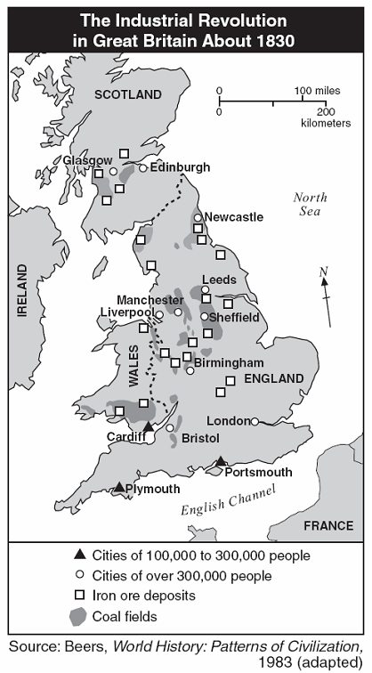
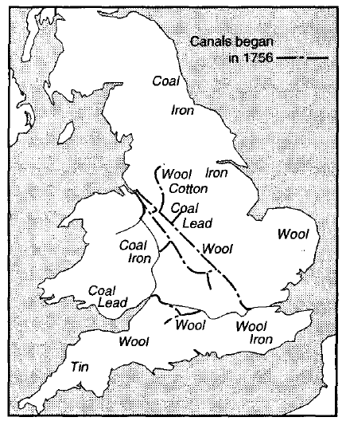

Slide 6
Textile Industry – the First to Industrialize
Textile = the manufacture of cloth
Britain’s textile industry clothed the world in wool, linen, and cotton. With an increasing population, demand for clothing in Britain increased dramatically.
New inventions such as the flying shuttle and the spinning jenny increased productivity
Some machines used water to increase power and production
Larger machines took up entire rooms and forced mill owners to create large buildings to house these machines (factories)

Slide 7
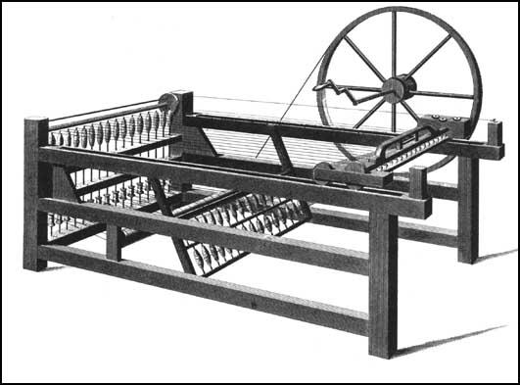
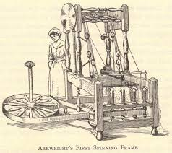
Spinning Jenny

Slide 8
Why is the cotton gin important?
Invented by Eli Whitney in 1794
Previously cotton seeds had to be removed from the raw cotton by hand
The cotton gin increased the amount of cotton that could be cleaned
Cotton gin = HUGE increase in production of cotton

Slide 9
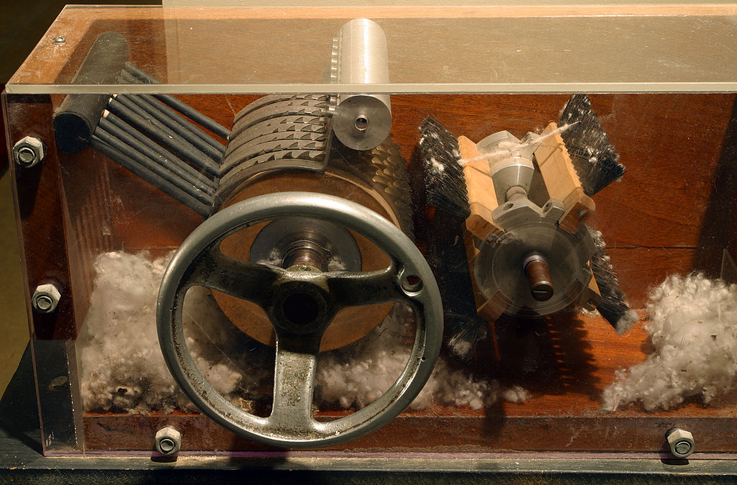
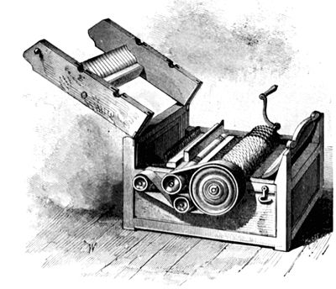
Cotton Gin video: http://havefunwithhistory.com/movies/cottonGin.html

Slide 10
Improvements in Transportation
Steam engine created by James Watt because other industries were looking for a cheap, convenient source of power
Steam engines led to steamboats that carried passengers up and down rivers across England
Water transportation led to the creation of canal system
Canals allowed resources to be moved to factories in other parts of the country (factories no longer had to be located next to resource)

Slide 11
Improvements in Railway Transportation
A steam engine on wheels was created called a locomotive
Railways quickly connected coal fields to factories in the larger cities
Railroads had four major impacts:
  1. Cheap way to transport materials and finished products
  2. Created thousands of jobs building railroads
  3. Increased profits of agricultural and fishing industries because goods could be sent to distant cities
  4. Railroads encouraged people to live in the countryside (quick transportation to city)

Slide 12
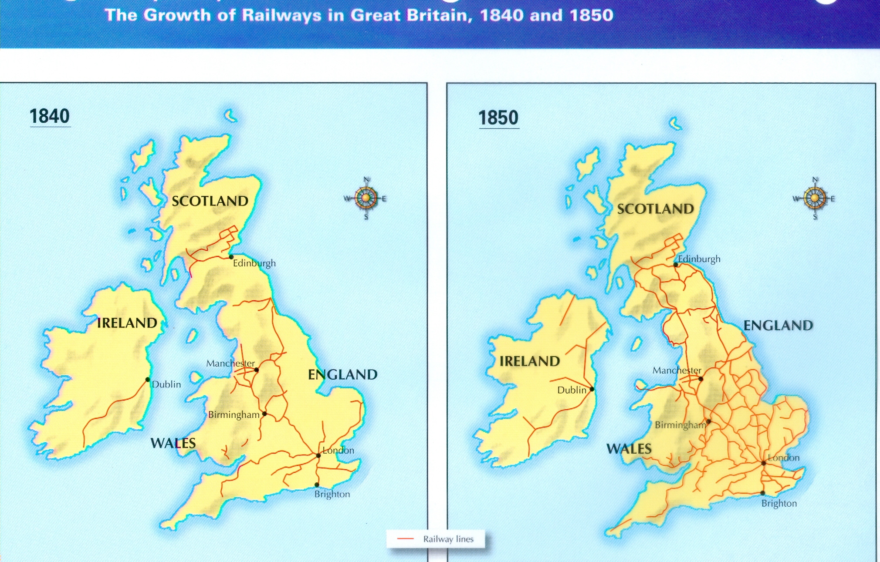

Slide 13
Industrial Revolution Spreads
Some mill workers emigrated to other parts of the world in search of better lives
They took with them the ideas and innovative way of thinking from Britain
Some individuals were able to recreate objects from British factories (Samuel Slater came to U.S.)
Railroads spread people across the United States and continental Europe
Growth of population, natural resources, and advancements in transportation determined the degree to which countries industrialized

Slide 14
Impact of Industrialization
Industrialization widened the gap between industrialized and non-industrialized countries
Britain began exporting resources from its colonies
The need for additional resources for manufacturing led to increase in imperialism (practice of building an empire of territories)
Colonies were again used as a source of raw materials and a market to sell manufactured products
Industrialization increased power of Europe and other industrialized countries

