Slide 1
World History Basics Vocabulary
Directions: Confirm or Correct
the responses on your vocabulary sheet

Slide 2


Democracy
(1) A form of government in which political power is exercised by all citizens.

Slide 3
Monarchy
(2) Rule by a king or queen.

Slide 4
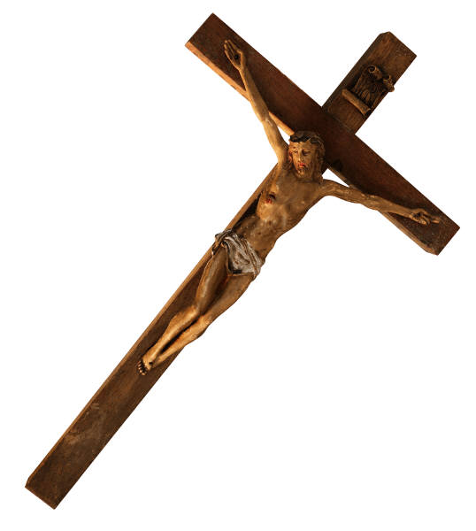
Theocracy
(3) Rule by god or a higher power.

Slide 5
Anarchy
(4) Form of government where no one is in charge.

Slide 6
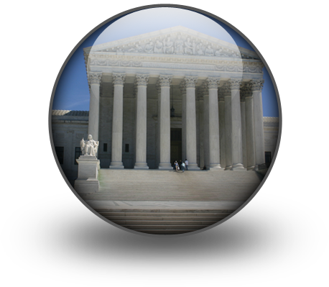
Direct Democracy
(5) People directly control and are responsible for the laws of their society.

Slide 7

Autocracy
(6) Political power is controlled by one individual.

Slide 8
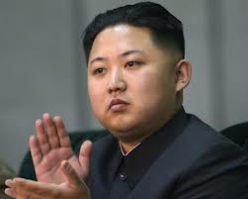
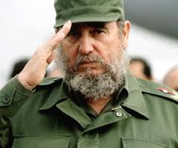
Dictatorship
(7) Absolute power of a country which is usually taken by force.

Slide 9
Oligarchy
(8) “Rule by Few”

Slide 10
Representative Democracy
(9) People elect leaders to write and manage laws for the country.

Slide 11
Market Economy
(10) Most goods and services are offered by private companies.
(aka capitalism)

Slide 12
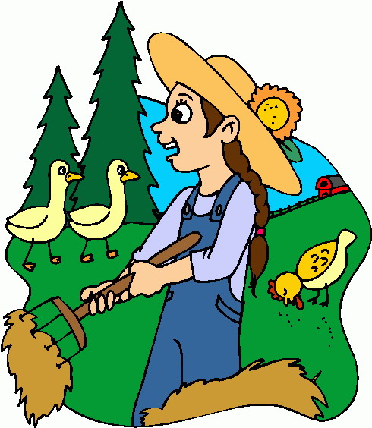
Traditional Economy
(11) Economic system based on traditions, customs, and beliefs

Slide 13
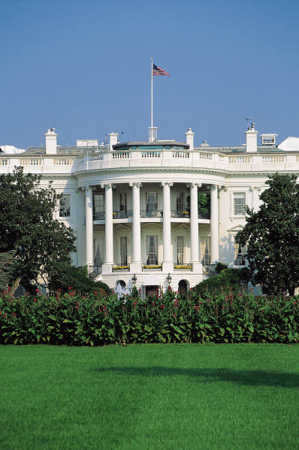
Mixed Economy
(12) Combination of both government owned and privately owned businesses.

Slide 14
Tariff
(13) Taxes on goods from other countries

Slide 15

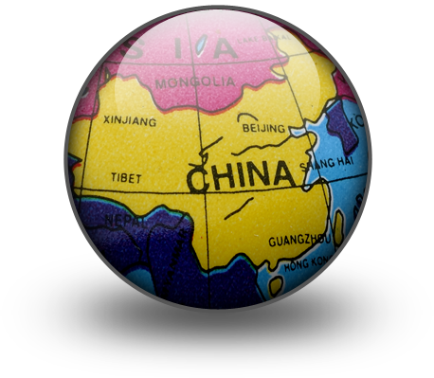
Command Economy
(14) The government owns and offers all goods and services and decides their costs.
(aka communism)

