Slide 1
The Chinese Columbus

Slide 2
How do we know what we know?
Where do we learn information about the explorers?
How do we find out the information about the European explorers?
How do we know that is what actually happened?

Slide 3
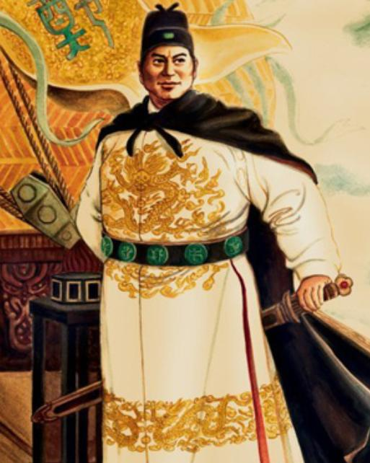
Zheng He

Slide 4
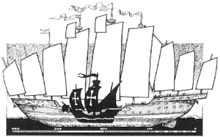
 | Christopher Columbus | Zheng He
Number of Ships | 3 : Nina, Pinta, Santa Maria | 300 treasure ships
Size of ships | Largest: 85 feet long, 40 feet wide | 600 feet long, 180 feet wide Size of small aircraft carrier
Weight of ships | unknown | At least 1500 tons
Number of masts on ships | 3 | 9
Number of people on ships | 90 | 700
Summary of Entire Fleet | 3 ships, manned by almost 300 people | More than 300 ships, manned by more than 27,000 officers and men
Home Country | Spain | China
Years of Voyage | 1492-1504 | 1405-1433

Slide 5
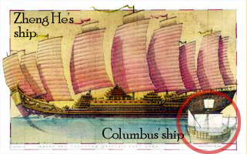

Slide 6
Why was Zheng He sent on these voyages?
To sail to “the countries beyond the horizon” ”all the way to the end of the earth”
To display the might of Chinese power and collect foreign money
Sent by Chinese Emperor Yong Le
Emperor appointed him “Admiral of the Western Seas”

Slide 7
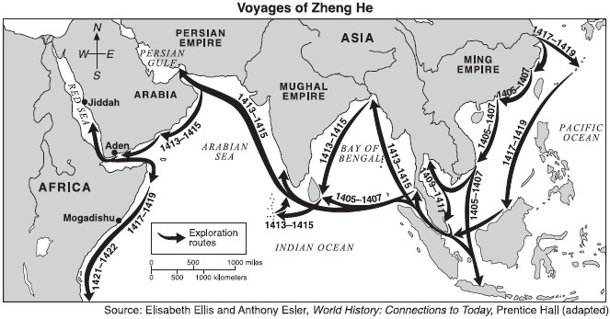
How far did he travel?
He visited over 30 nations from Asia to Africa
He traveled about 35,000 miles

Slide 8
What was carried on the vessels?
As many as 27,000 men: sailors, navigators, doctors, scribes, shipwrights and cooks
Muslim religious leaders and Buddhist monks for religious ceremonies

Slide 9
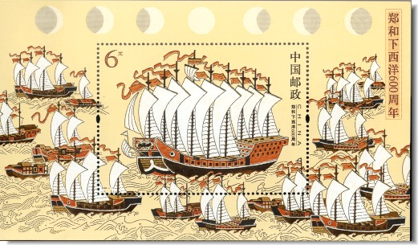

Slide 10
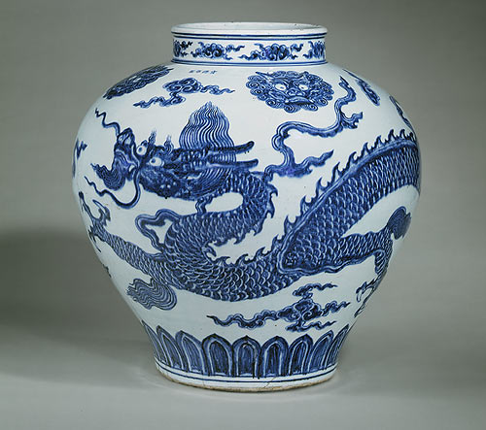
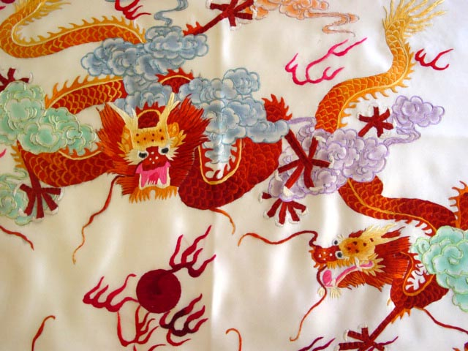
What did the Chinese take to trade with foreign merchants?
Famous blue and white Ming porcelain dishes, vases and cups
Chinese silk, cotton printed with Chinese designs
Gold and silver, iron tools, copper kitchenware and perfumes

Slide 11
In exchange for the Chinese goods, what did the foreign merchants give to Zheng He to take back to China?
Medicinal herbs, dyes, spices
Precious gems, pearls, rhinoceros horns, and ivory
Exotic animals

Slide 12
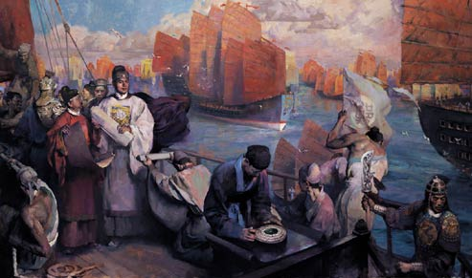
Why did the Chinese end their overseas exploration?
New Emperor = new war
New allocation of resources no longer allowed for added exploration

Slide 13
Voyages of Zheng He

Slide 14
Template Provided By
www.animationfactory.com
500,000 Downloadable PowerPoint Templates, Animated Clip Art, Backgrounds and Videos

